Slide 1


Director and Company Secretary’s Module
MODULE 10

Slide 2

Requirements Gathered
Director and Company Secretary’s Module

Slide 3
View reports
Make adjustments to trial balance
Communicate among workers
Among director, secretary AND clerk, accountant, auditor.
Do some changes, editing to the credit and debit ledgers.
See accounts’ information
Shall be able to generate, edit, view and print audited directors' report annually.
Whether the account had finished or not.
Whether the account had been audited or not.

Slide 4
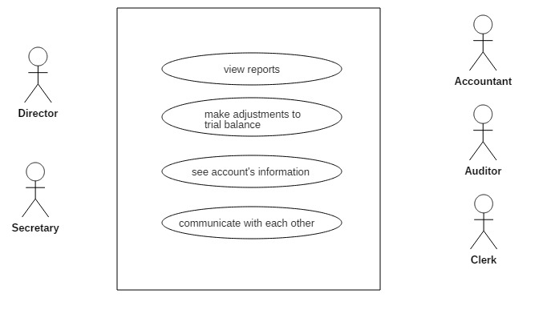
System
Director and Secretary View Use Case Diagram

Slide 5
Architectural Design
Director and Company Secretary’s Module

Slide 6
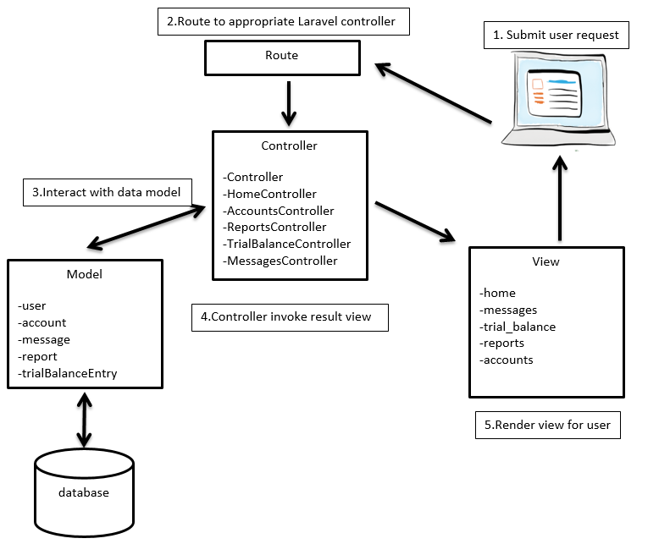

Slide 7
Entity Relationship Diagram (ERD)
Director and Company Secretary’s Module

Slide 8
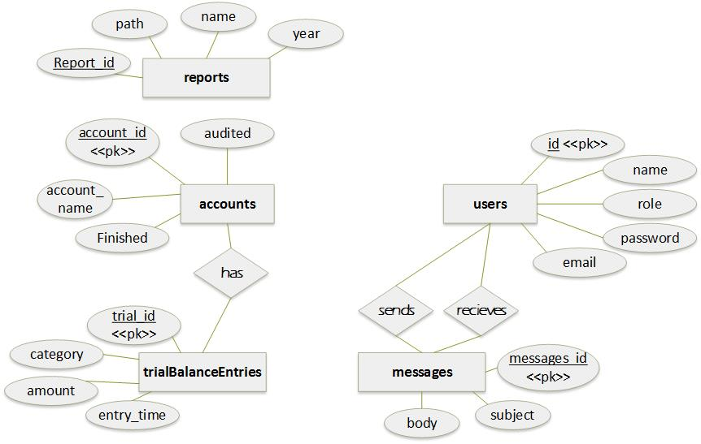

Slide 9
User Interface / Demo
Director and Company Secretary’s Module

Slide 10
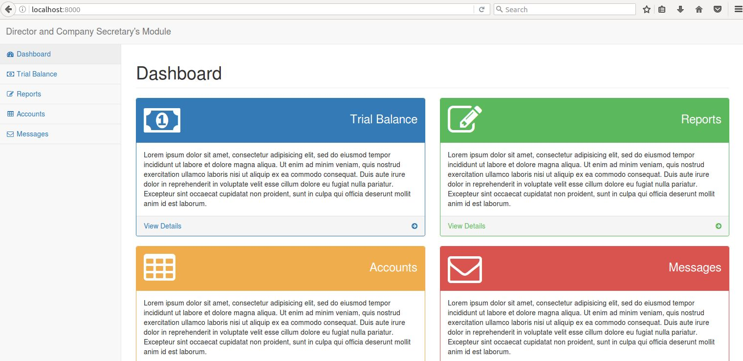

Slide 11
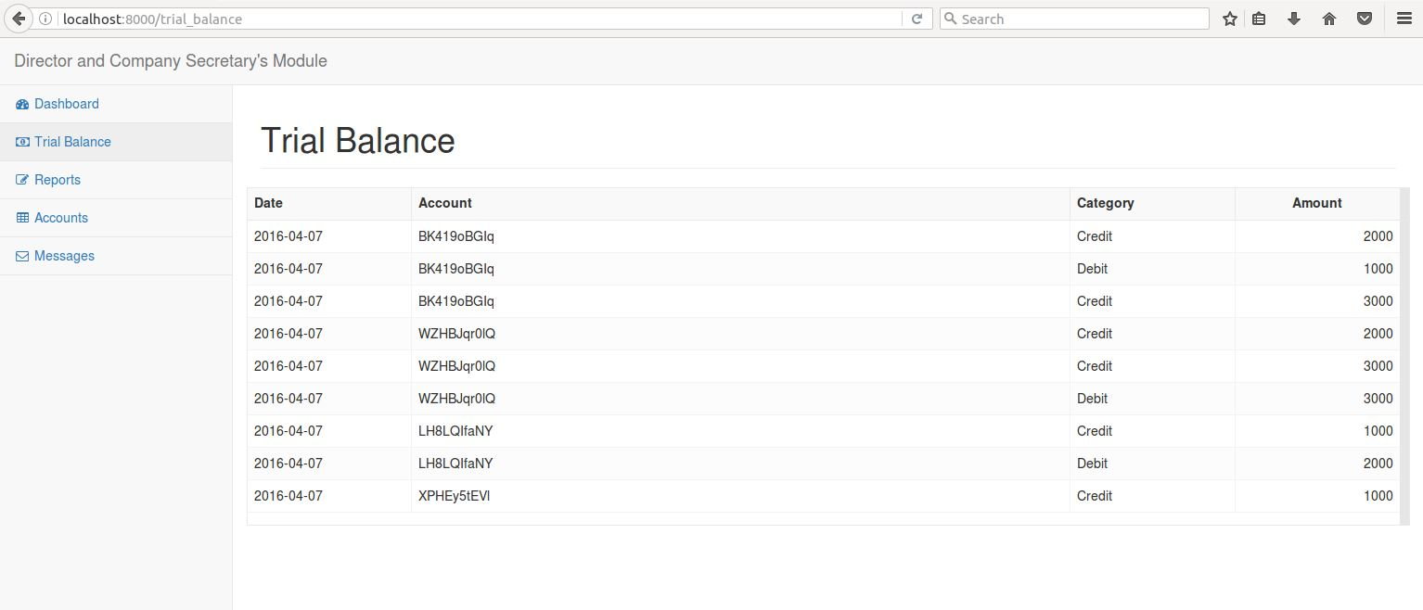

Slide 12
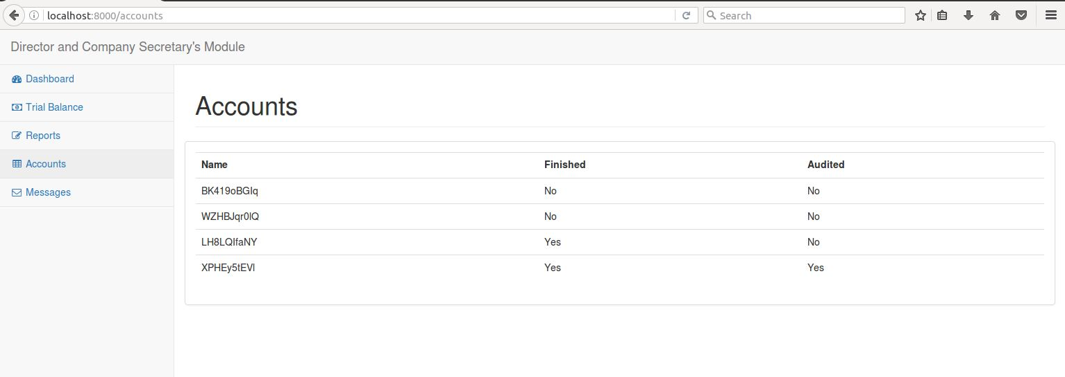

Slide 13
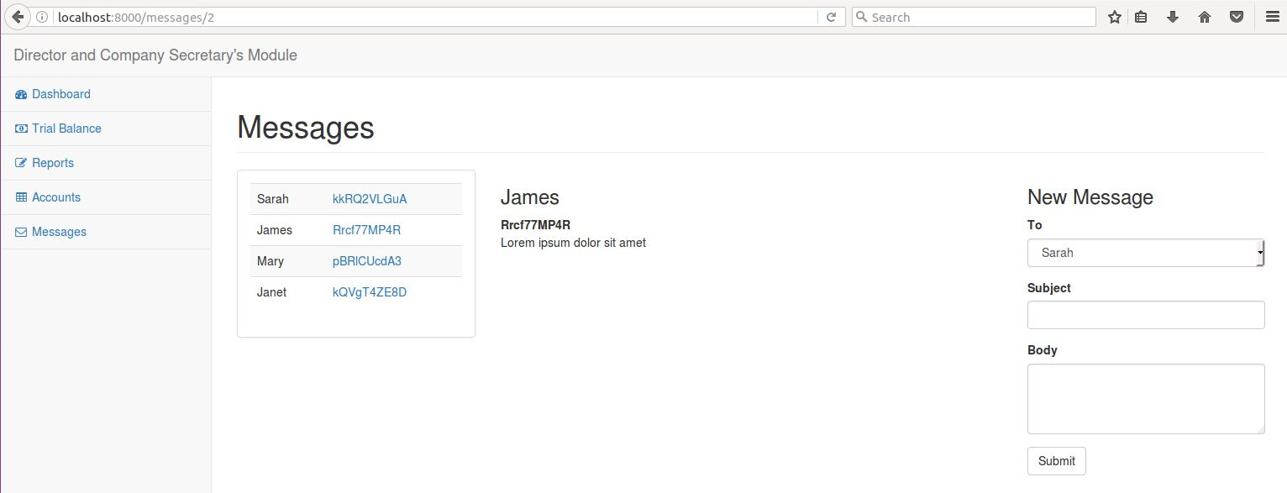

Slide 14
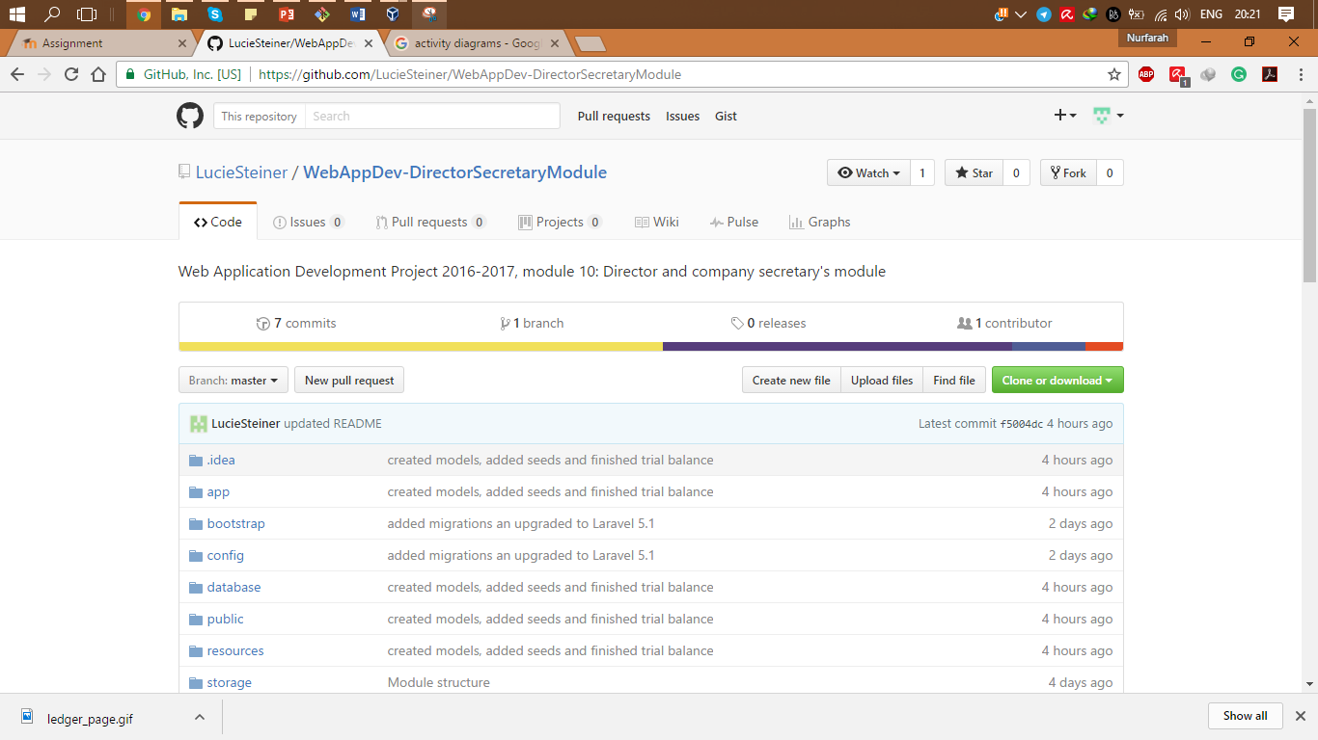
https://github.com/LucieSteiner/WebAppDev-DirectorSecretaryModule.git

Slide 15
